Slide 1

A 170-260 GHz SiGe Frequency Doubler with 5-dBm Output Power and 13-dB Input Power Range EuMIC02- 23/09/2024 Jonathan Tao, Eythan Lam, James Buckwalter University of California, Santa Barbara jgtao@ucsb.edu

Slide 2
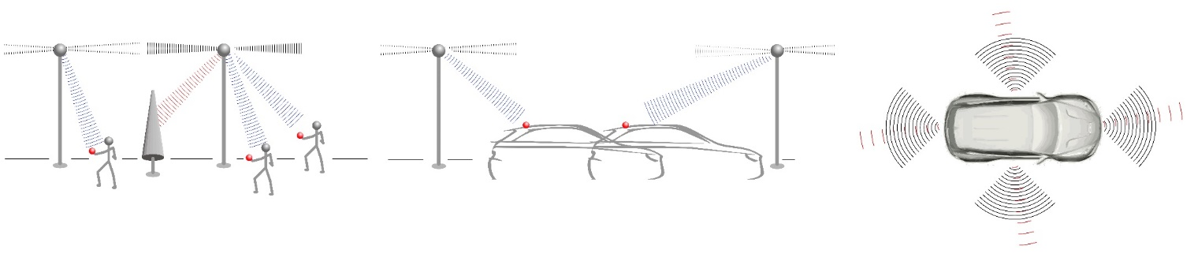
Motivation
Power budget prohibitive for mobile transmit/receive systems above 100 GHz, 6G
Reduce power through
Use of different semiconductors, heterogenous integration
Architectural optimization in array scaling to target a different SNR
Circuit techniques
Power Estimate: P. Skrimponis et al., “Power Consumption Analysis for Mobile MmWave and Sub-THz Receivers,” in 2020 2nd 6G Wireless Summit (6G SUMMIT), Mar. 2020, pp. 1–5. doi: 10.1109/6GSUMMIT49458.2020.9083793.

Slide 3
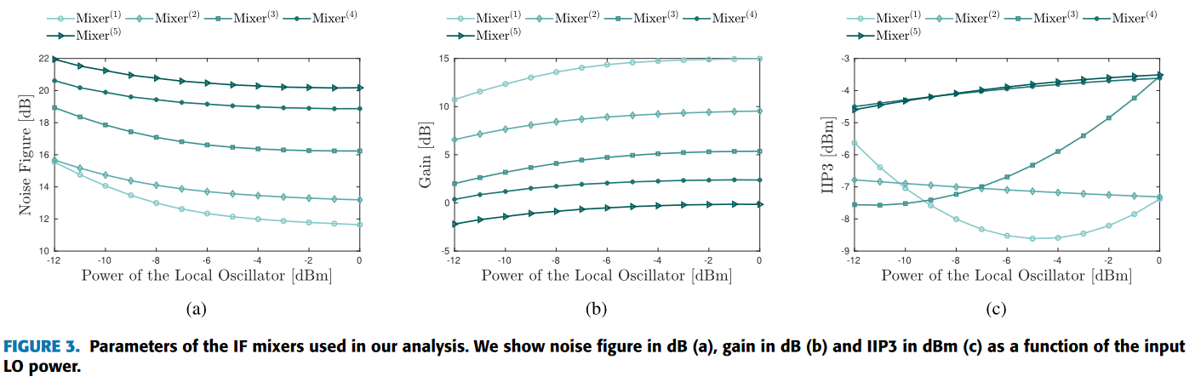
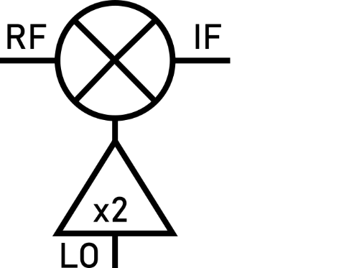
Motivation
LO power dominates system power consumption
Conventional frequency multipliers are driven at maximum with a single saturating power
Permanently sets performance for an architecture
Want dynamic trade-off between LO power requirement and system performance for highly dynamic wireless channels
Want a frequency multiplier that can handle a range of LO input powers
Architectural Optimization: P. Skrimponis et al., “Towards Energy Efficient Mobile Wireless Receivers Above 100 GHz,” IEEE Access, vol. 9, pp. 20704–20716, 2021, doi: 10.1109/ACCESS.2020.3044849.

Slide 4
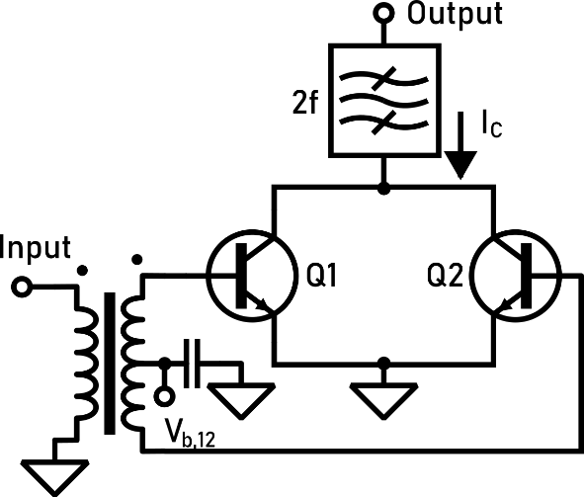
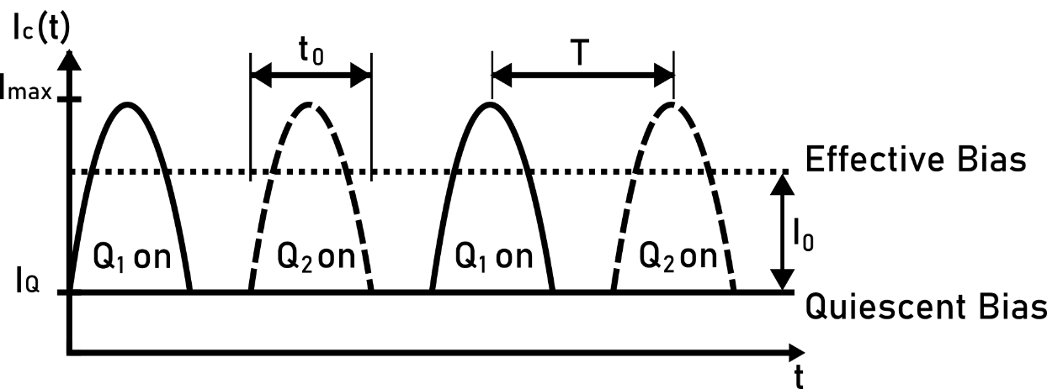
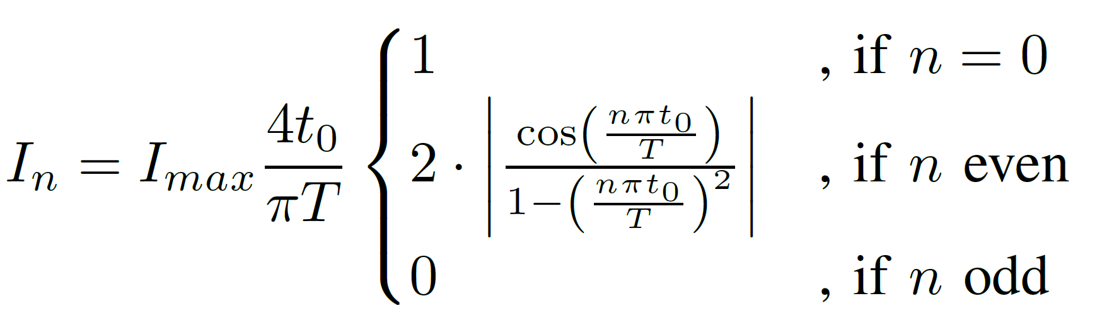
Push-pull Frequency Doublers
Conventional Doubler
Input signal is rectified to produce an output waveform
Fourier series of output current:
✅ Output contains even harmonics (desired)
Output also contains an additional DC current I₀
☠️ Affects biasing and gain

Slide 5
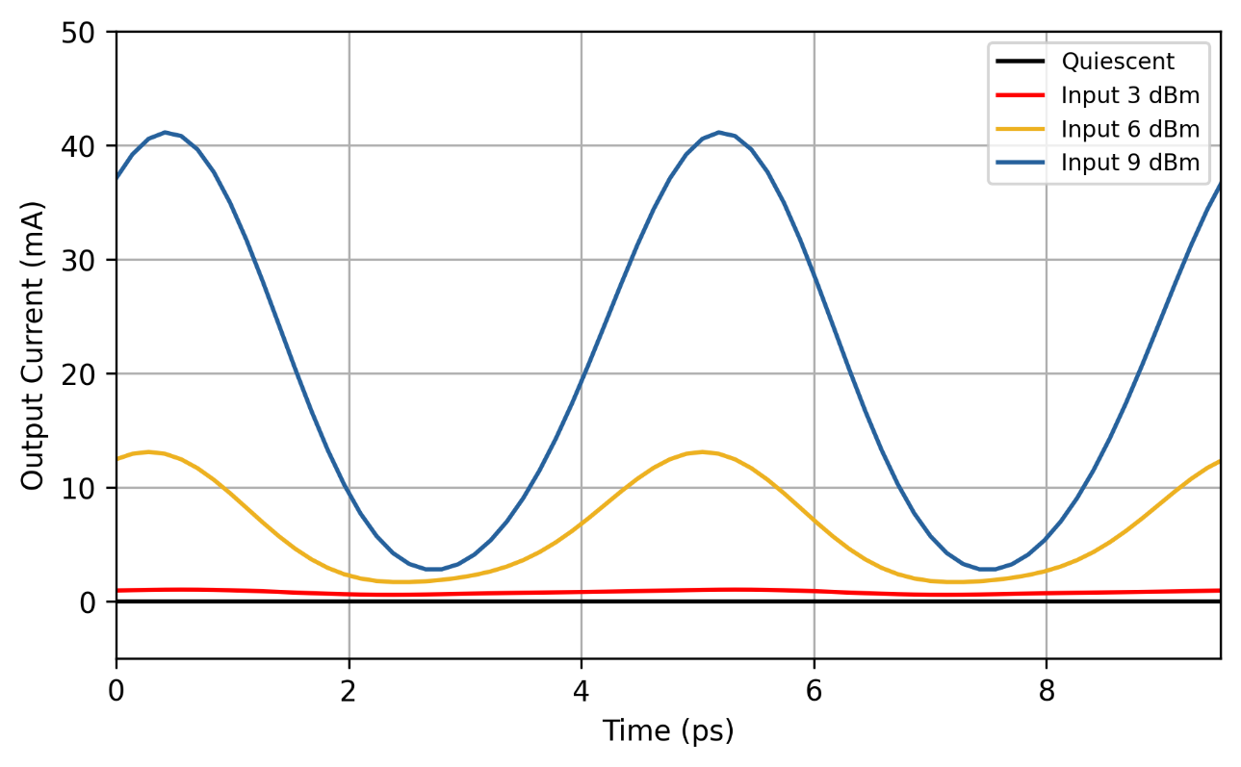
Effect of Output on DC Bias
Output waveform adds DC bias current by I₀
Transistor loses current density and gain at lower powers
Change bias to compensate?
Simulated (Transistors only, no filtering)

Slide 6
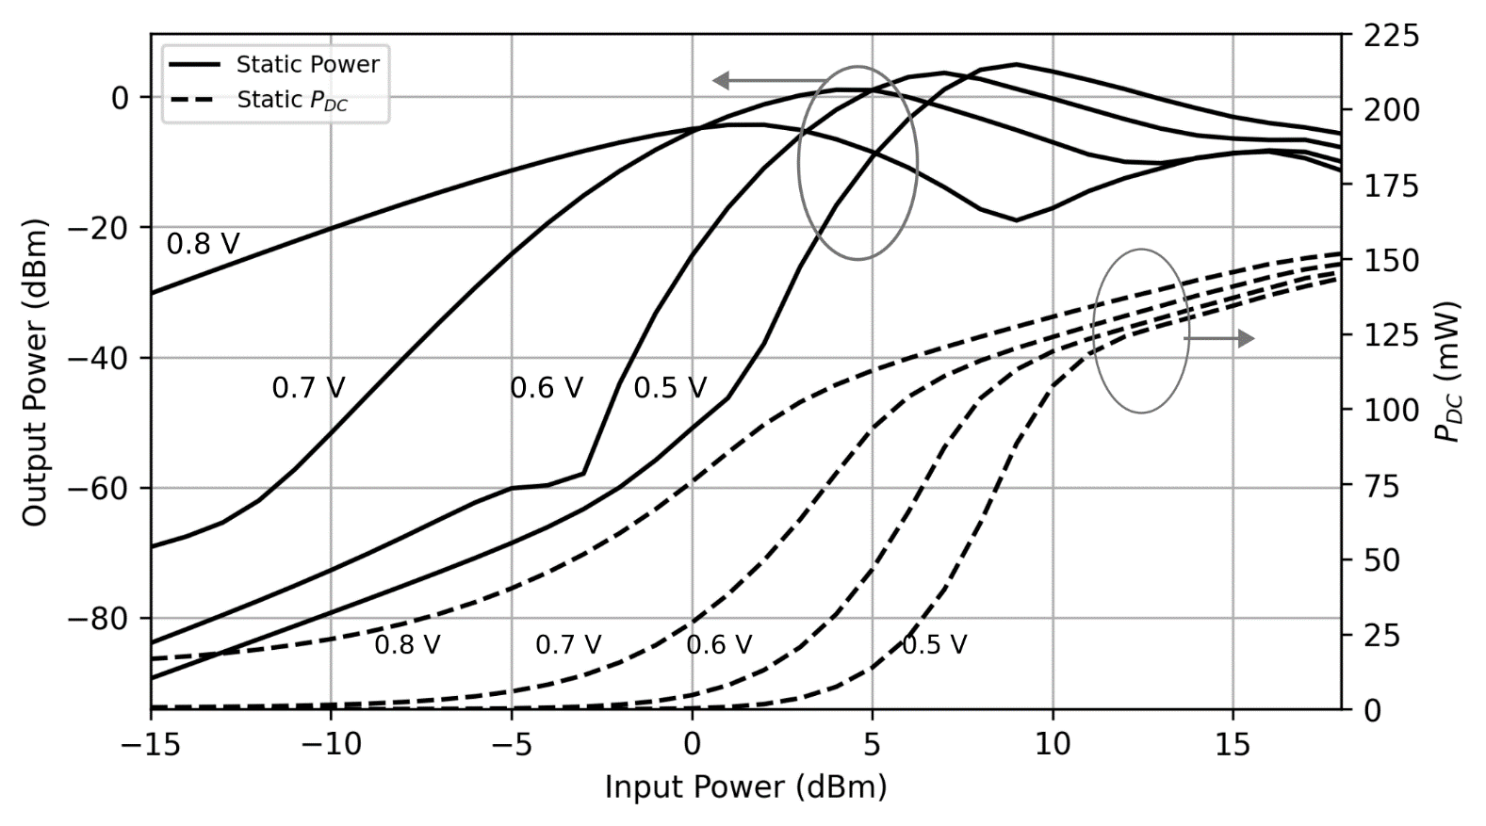
Simulated Effect of Static Biasing
Requires a choice of bias
☠️ High gain sensitivity to input power

Slide 7
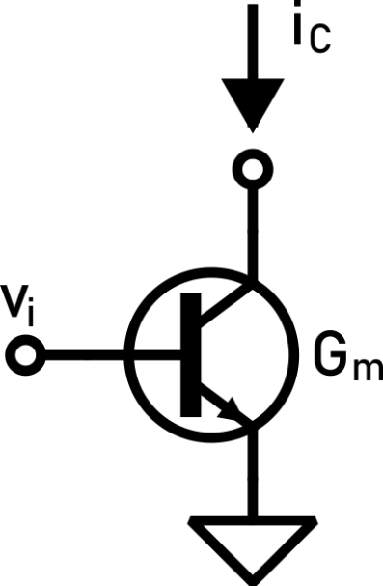
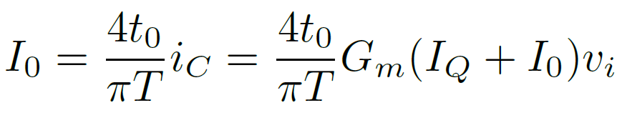
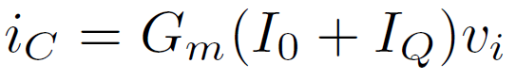
Problem: Additional DC Current I₀
DC current sensitivity results in non-linear gain
Extreme sensitivity to input power
Solutions:
Operate at a single saturating LO power or
Enforce current density to eliminate additional DC current I₀

Slide 8
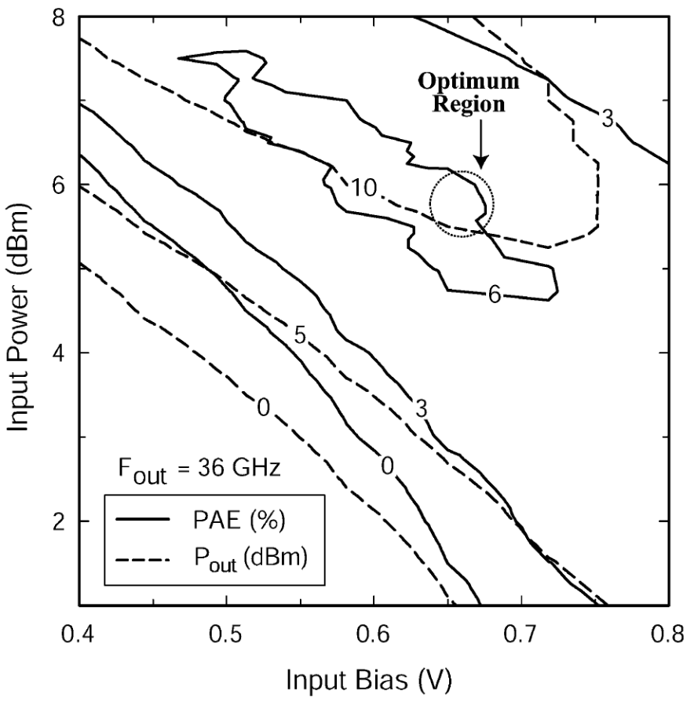
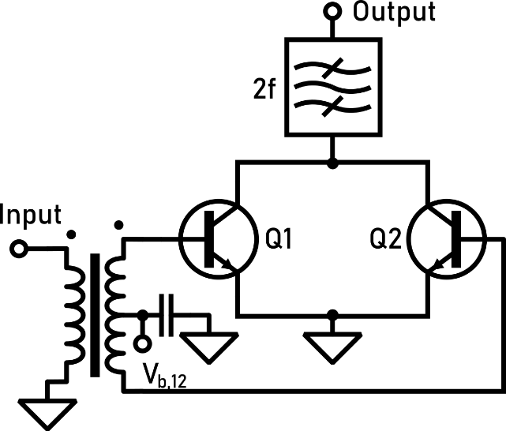
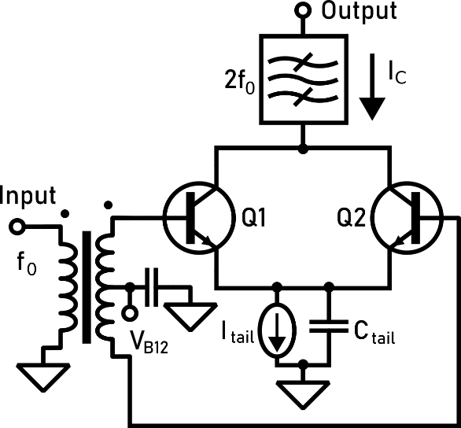
Conventional Approaches
Static Bias Approach
Current Tail Approach
[Hung 2005]
Set an optimum input bias V_{B12} for an input power
☠️ No bias enforcement
☠️ Gain changes with input power (high sensitivity)
☠️ Limited output power when voltage is tuned for a lower input power
✅ Bias enforced with tail current source
✅ Gain maintained across input power
☠️ Higher power dissipation from current source with higher loss
J.-J. Hung, T. M. Hancock, and G. M. Rebeiz, “High-power high-efficiency SiGe Ku- and Ka-band balanced frequency doublers,” IEEE Transactions on Microwave Theory and Techniques, vol. 53, no. 2, pp. 754–761, Feb. 2005, doi: 10.1109/TMTT.2004.840615.
U. Soylu, A. Alizadeh, M. Seo, and M. J. W. Rodwell, “280-GHz Frequency Multiplier Chains in 250-nm InP HBT Technology,” IEEE Journal of Solid-State Circuits, vol. 58, no. 9, pp. 2421–2429, Sep. 2023, doi: 10.1109/JSSC.2023.3292182.

Slide 9
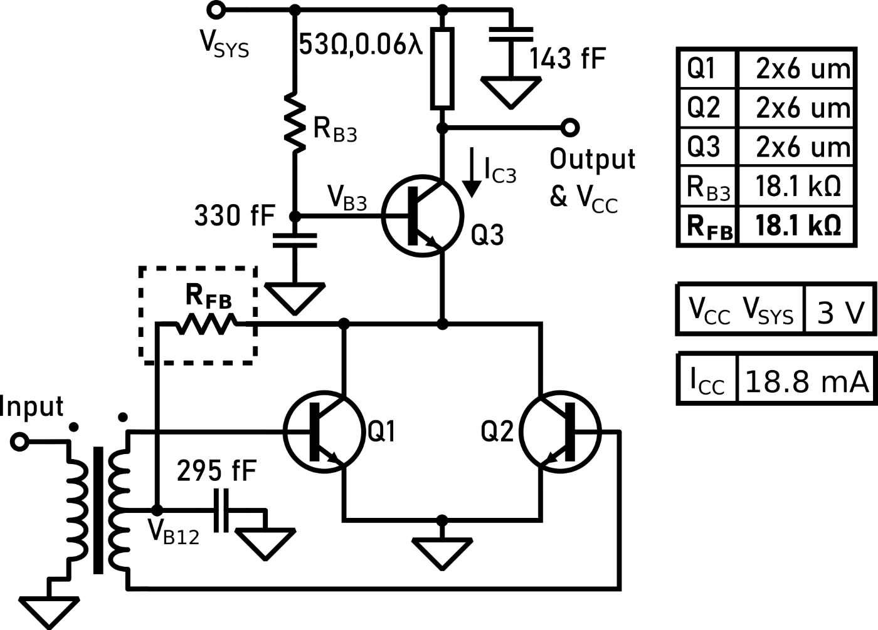
Proposed Design of This Work
Q1/Q2: Main push-pull doubler
Q3 provides
Amplification
Suppression of Miller Effect
Biasing
Feedback resistor R_{FB} adapts bias to resist additional current caused by input power changes

Slide 10
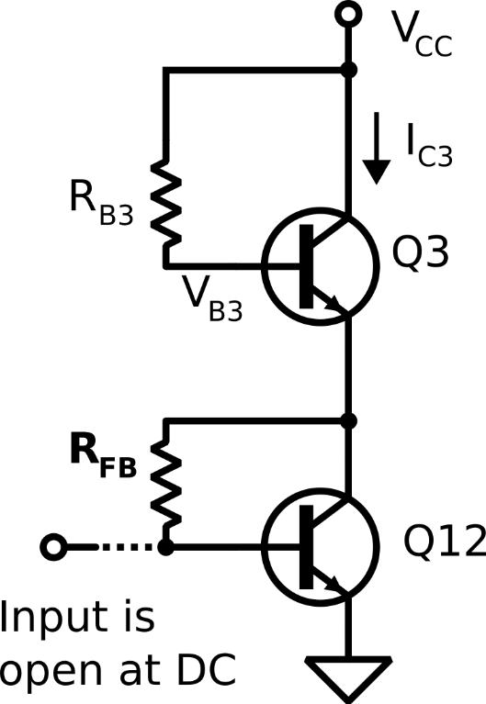
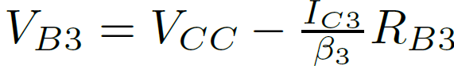
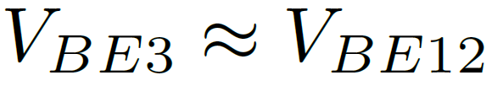
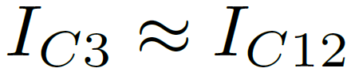
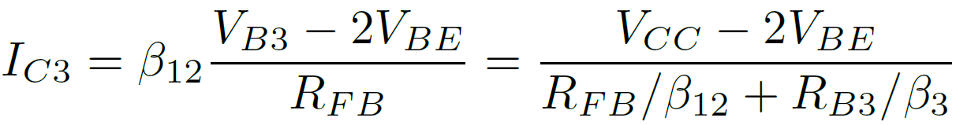
DC Bias: Suppress Current Change
Equivalent DC Model
Q1 and Q2 shorted at DC: treat as combined Q12
Assumptions:
Bias current is ultimately set by VCC, resistances, and β
Current change suppressed by negative feedback on V_{BE}

Slide 11
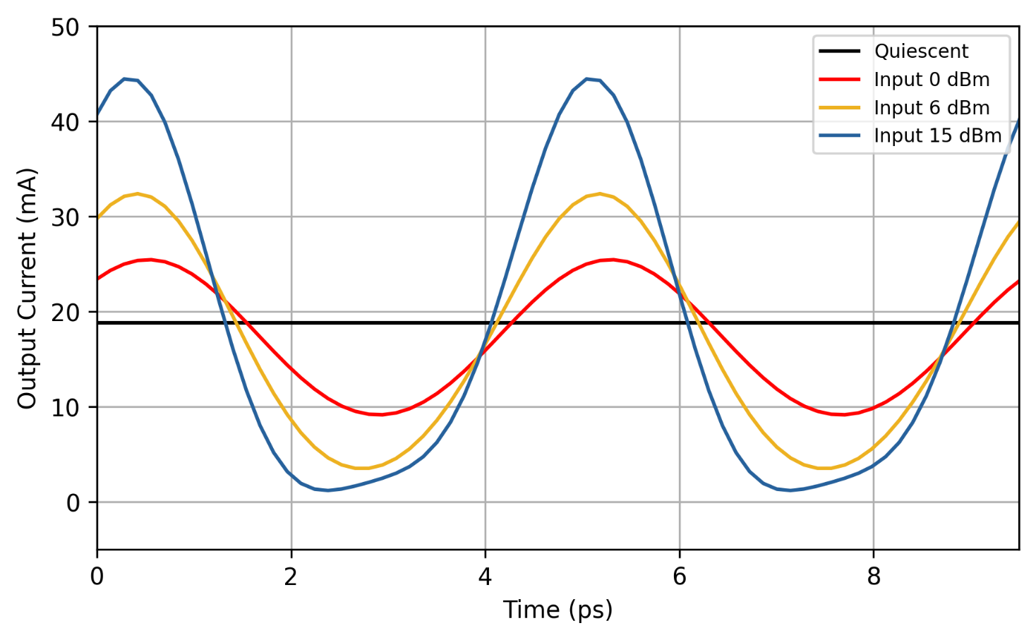
Effect of Feedback on DC Bias
DC bias is constant
Transistor current density is maintained across power range
Simulated (Transistors only, no filtering)

Slide 12
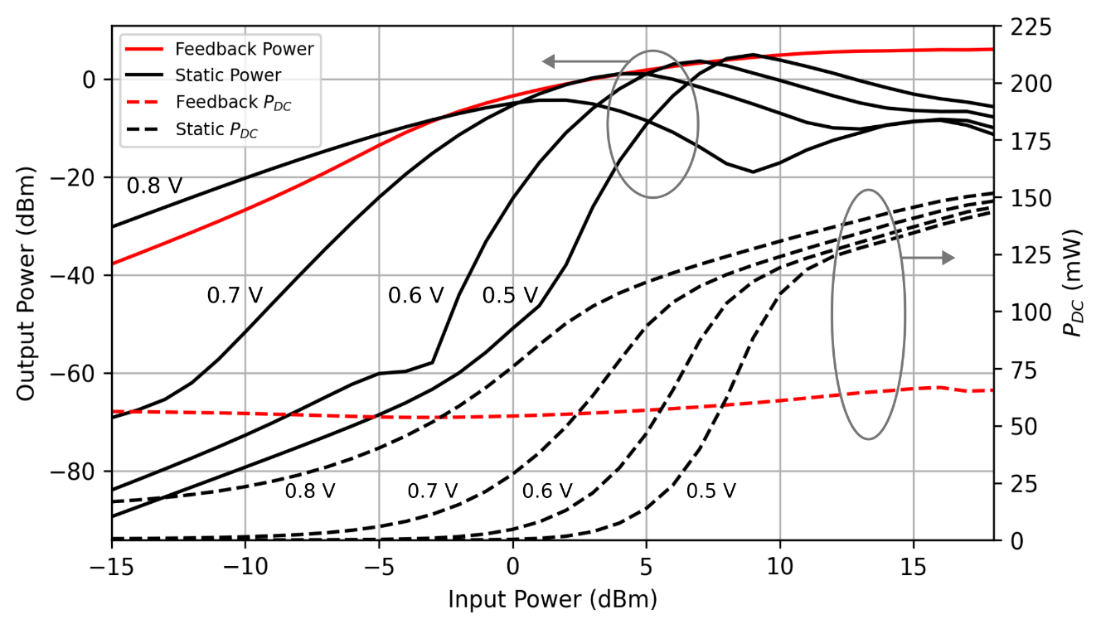
Simulated Effect of Bias Feedback
Bias maintained across input powers
✅ Less gain sensitivity leading to control of output power
✅ Delivers same maximum output power as a tuned static bias for each input power

Slide 13
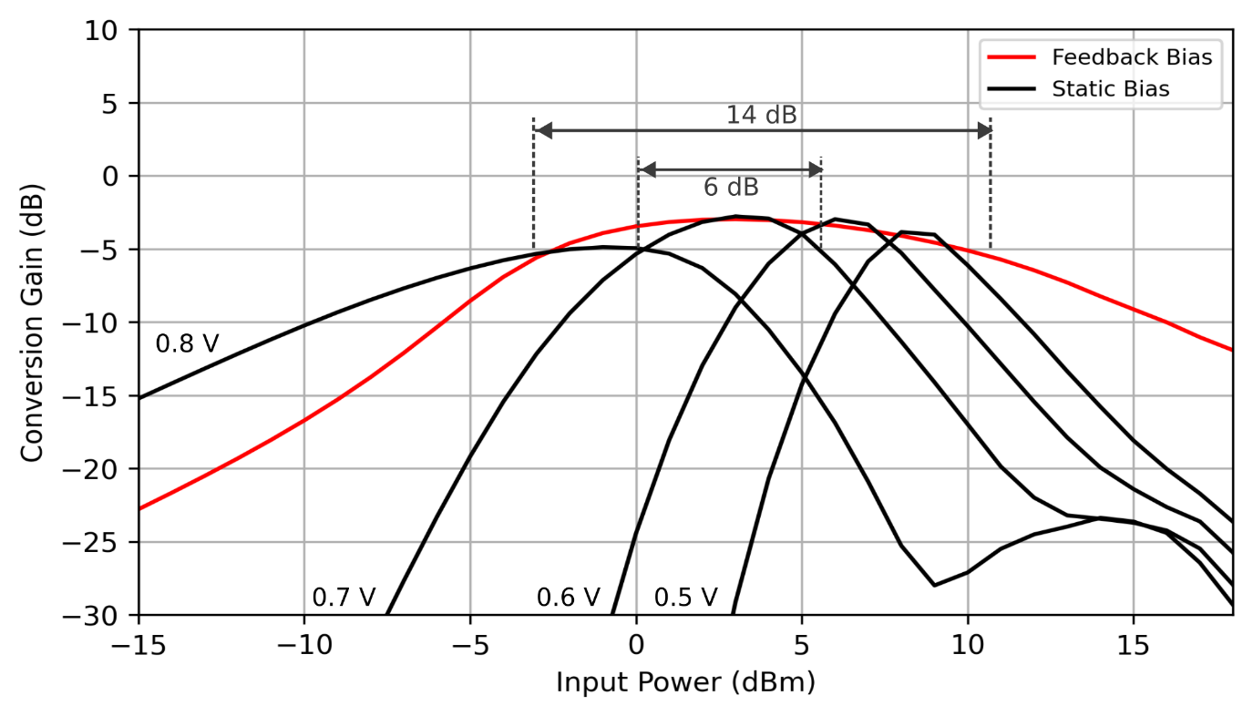
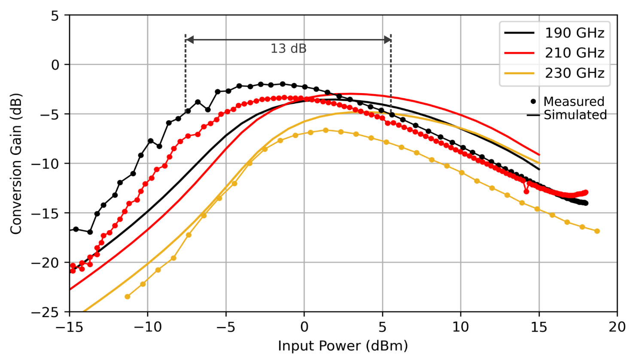
Measured Gain Over Input Power
Adaptive bias feedback technique reduces input power sensitivity
Demonstrated 13 dB input power range where gain is within 3 dB
Simulated Comparison: Static vs. Feedback Bias (210 GHz)
Measured Gain vs. Input Power

Slide 14
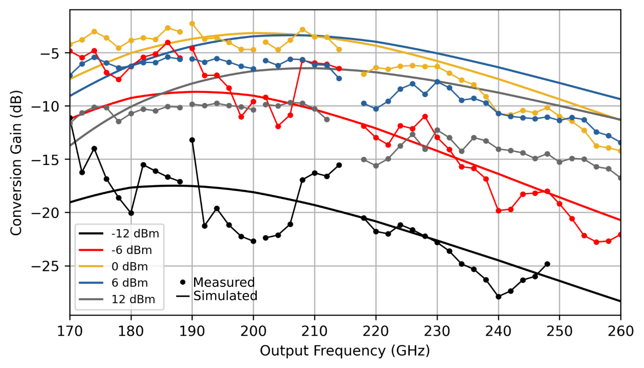
Measured Gain Across Frequency
3-dB bandwidth of 48 GHz
Adaptive bias feedback works across frequency
Measured Gain vs. Frequency for an Input Power

Slide 15
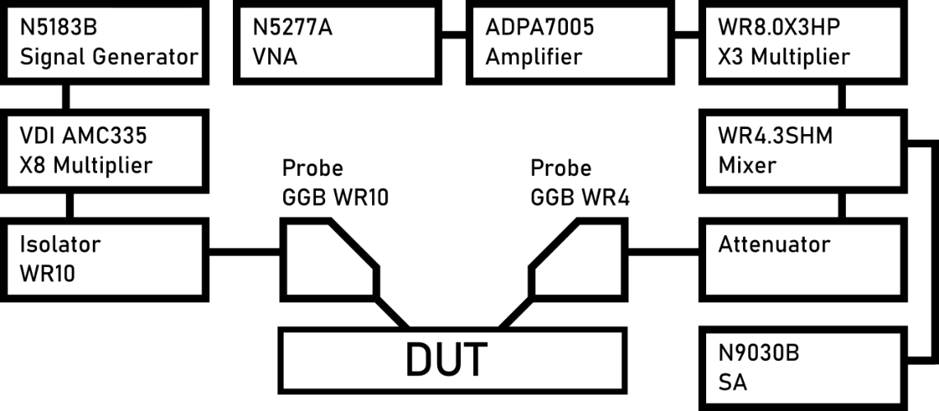
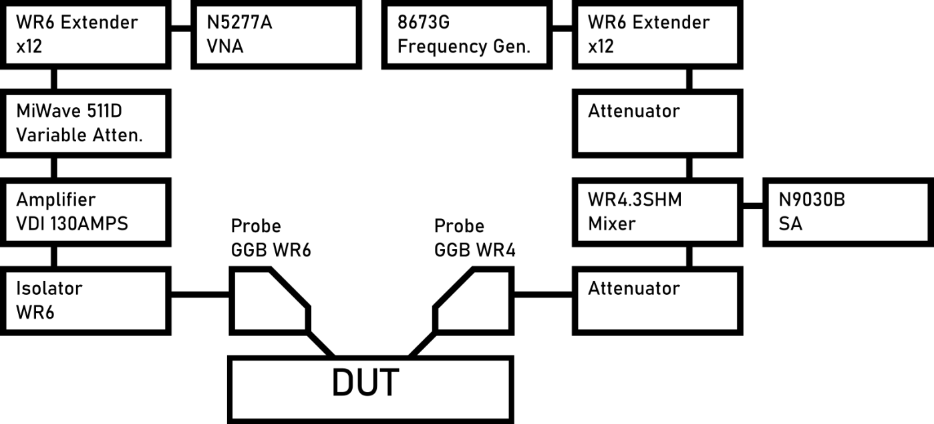
Measurement Setup
Multiple setups used to cover entire frequency band
W-band Setup
Input: 75 GHz – 110 GHz
(Power controlled by signal generator power level)
Output: 170 GHz – 260 GHz
D-band Setup
Input: 110 GHz – 170 GHz
(Power controlled by variable attenuator)
Output: 170 GHz – 260 GHz

Slide 16
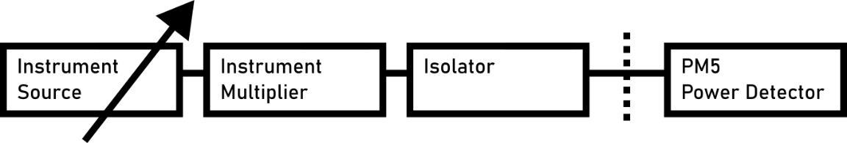
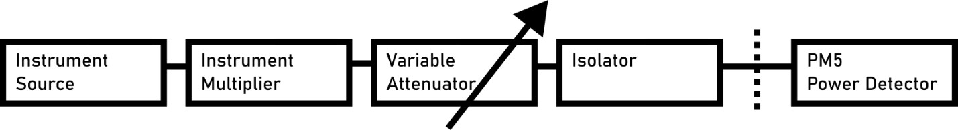
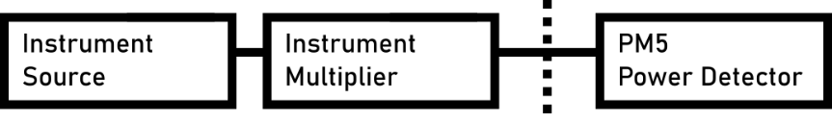
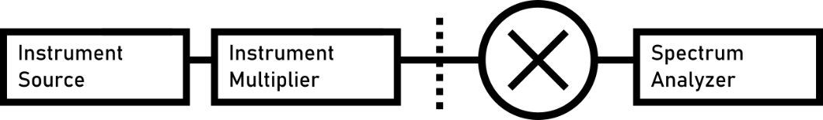
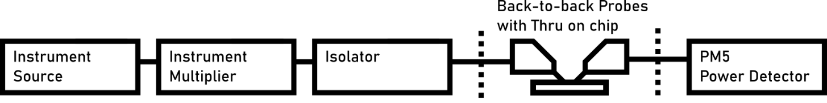
Measurement Setup: Calibration
Input with power meter (Map power setting to input power)
Down-conversion at output frequencies with spectrum analyzer
Probe loss
W-band (75 GHz – 110 GHz)
D-band (110 GHz – 170 GHz)
G-band (170 GHz – 260 GHz)
G-band (170 GHz – 260 GHz)
W-band, D-band, G-band

Slide 17
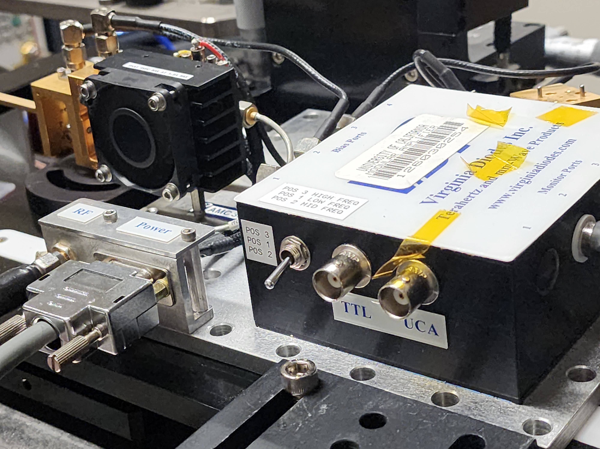
Measurement Setup: Ranges
1
2
3
Frequency gaps correspond to instrument ranges
High instrument uncertainty when controlled with input power: Instrument multiplier sensitivity
W-band
D-band

Slide 18
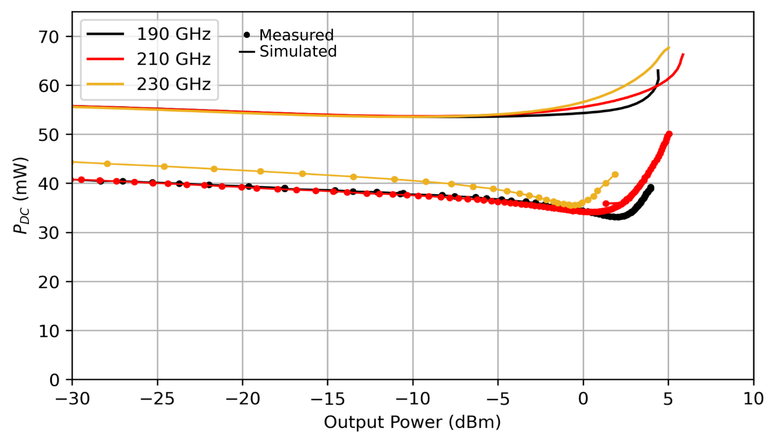
Feedback Maintains Bias
Adaptive bias feedback eliminates additional DC current created by output waveform
P_{DC} is held constant by feedback bias
Measured Power Consumption vs. Output Power

Slide 19
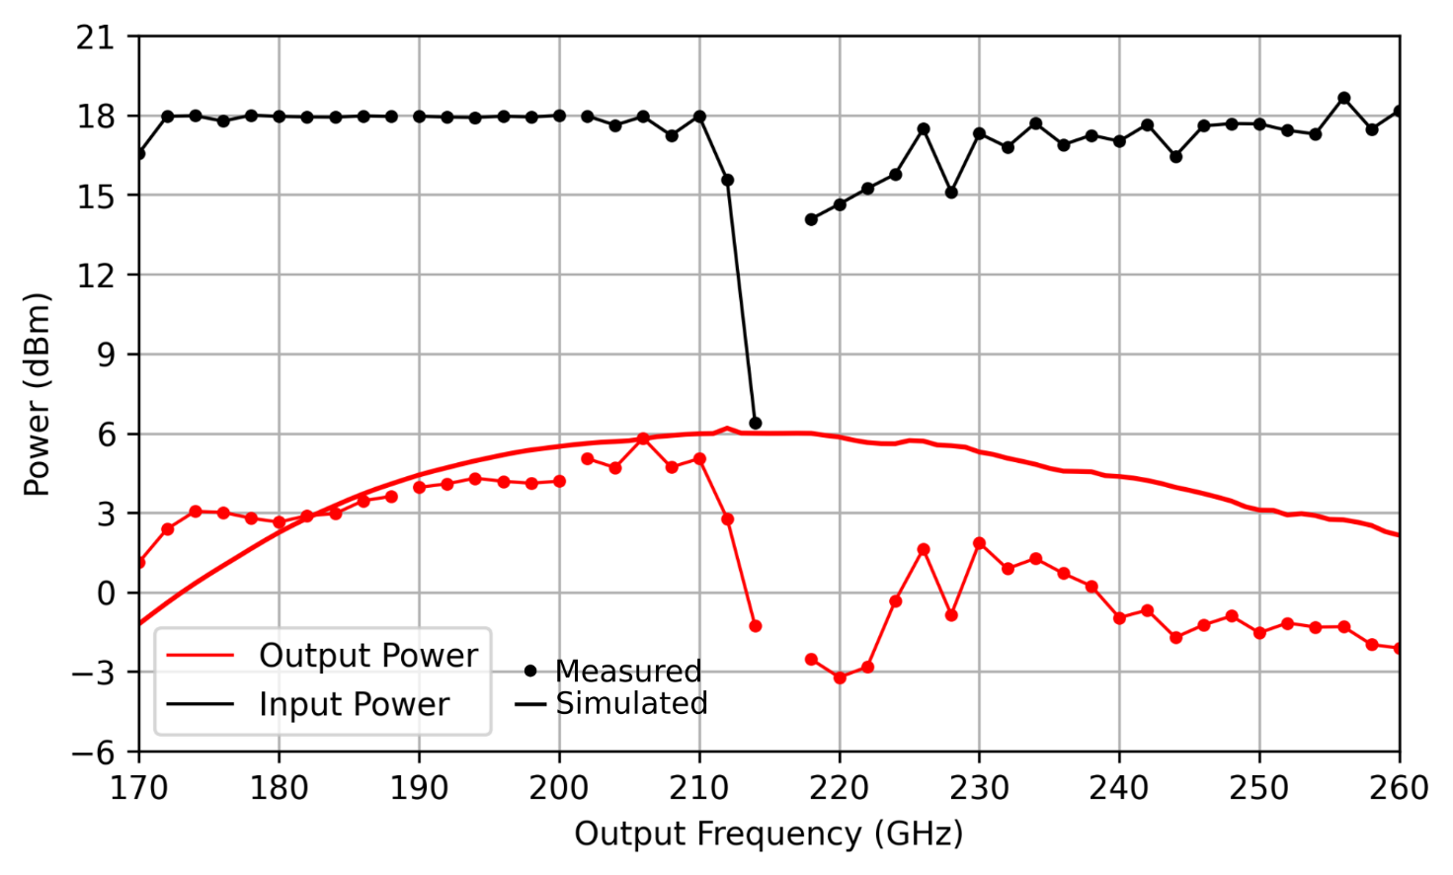
Saturated Output Power
Demonstrated > -3.3 dBm from 170 GHz to 260 GHz.
Maximum 5.8 dBm at 206 GHz with 18 dBm of input power.
Highest Demonstrated Output Power with Instrument Input Power

Slide 20
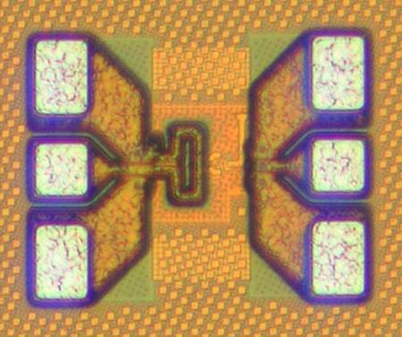
This Work: G-band Doubler
170-260 GHz SiGe Frequency Doubler with Adaptive Bias Feedback
90-nm SiGe BiCMOS (Global Foundries 9HP+)
Very compact!
0.095 mm x 0.135 mm
Without pads

Slide 21
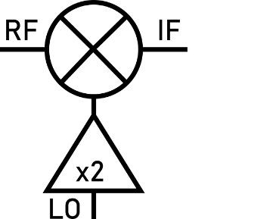
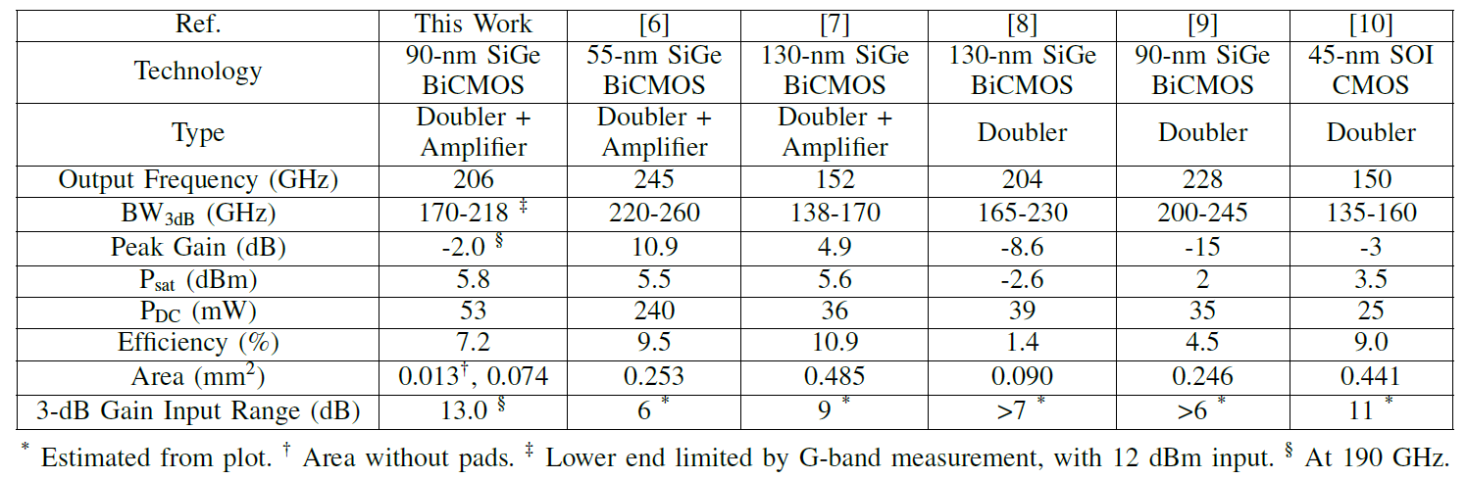
Comparison and Conclusion
Adaptive bias feedback (one resistor) enables large input power range
No penalty to area, power consumption, or output power
Enables dynamic system performance
Use varying LO power in an adaptive transceiver for different performance conditions

Slide 22



Acknowledgements
This work was supported by the Semiconductor Research Corporation (SRC) under the JUMP program, ComSenTer.
The authors appreciate the support of GlobalFoundries for access to the 9HP process.
The authors also thank Professor Gabriel Rebeiz for helping with the measurement.

Slide 23

Thanks!

Slide 24
Table References
[6] S. Shopov, A. Balteanu, J. Hasch, P. Chevalier, A. Cathelin, and S. P. Voinigescu, “A 234–261-GHz 55-nm SiGe BiCMOS Signal Source with 5.4–7.2 dBm Output Power, 1.3% DC-to-RF Efficiency, and 1-GHz Divided-Down Output,” IEEE Journal of Solid-State Circuits, vol. 51, no. 9, pp. 2054–2065, Sep. 2016, Conference Name: IEEE Journal of Solid-State Circuits, ISSN: 1558-173X. DOI: 10.1109/JSSC.2016.2560198.
[7] C. Coen, S. Zeinolabedinzadeh, M. Kaynak, B. Tillack, and J. D. Cressler, “A highly-efficient 138–170 GHz SiGe HBT frequency doubler for power-constrained applications,” in 2016 IEEE Radio Frequency Integrated Circuits Symposium (RFIC), ISSN: 2375-0995, May 2016, pp. 23–26. DOI: 10.1109/RFIC.2016.7508241.
[8] K. Wu, S. Muralidharan, and M. M. Hella, “A Wideband SiGe BiCMOS Frequency Doubler With 6.5-dBm Peak Output Power for Millimeter-Wave Signal Sources,” IEEE Transactions on Microwave Theory and Techniques, vol. 66, no. 1, pp. 187–200, Jan. 2018, Conference Name: IEEE Transactions on Microwave Theory and Techniques, ISSN: 1557-9670. DOI: 10.1109/TMTT.2017.2732953.
[9] H.-C. Lin and G. M. Rebeiz, “A 200-245 GHz Balanced Frequency Doubler with Peak Output Power of +2 dBm,” in 2013 IEEE Compound Semiconductor Integrated Circuit Symposium (CSICS), ISSN: 2374-8443, Oct. 2013, pp. 1–4. DOI: 10 . 1109 /CSICS. 2013 . 6659189.
[10] H.-C. Lin and G. M. Rebeiz, “A 135–160 GHz balanced frequency doubler in 45 nm CMOS with 3.5 dBm peak power,” in 2014 IEEE MTT-S International Microwave Symposium (IMS2014), ISSN: 0149-645X, Jun. 2014, pp. 1–4. DOI: 10.1109/MWSYM.2014.6848544.

